Slide 1
Loving God and Our Community

Slide 2
Thriving in Babylon

Slide 3
Who or what do you trust?
Dan 6
Dan 6
Dan 6

Slide 4
27 Daniel answered the king: “No wise man, medium, diviner-priest, or astrologer is able to make known to the king the mystery he asked about. 28 But there is a God in heaven who reveals mysteries, and He has let King Nebuchadnezzar know what will happen in the last days. Your dream and the visions that came into your mind as you lay in bed were these:

Slide 5
29 Your Majesty, while you were in your bed, thoughts came to your mind about what will happen in the future. The revealer of mysteries has let you know what will happen. 30 As for me, this mystery has been revealed to me, not because I have more wisdom than anyone living, but in order that the interpretation might be made known to the king, and that you may understand the thoughts of your mind.

Slide 6
31 “My king, as you were watching, a colossal statue appeared. That statue, tall and dazzling, was standing in front of you, and its appearance was terrifying. 32 The head of the statue was pure gold, its chest and arms were silver, its stomach and thighs were bronze, 33 its legs were iron, and its feet were partly iron and partly fired clay. 34 As you were watching, a stone

Slide 7
broke off without a hand touching it, struck the statue on its feet of iron and fired clay, and crushed them. 35 Then the iron, the fired clay, the bronze, the silver, and the gold were shattered and became like chaff from the summer threshing floors. The wind carried them away, and not a trace of them could be found. But the stone that struck the statue became a great mountain and filled the whole earth.

Slide 8
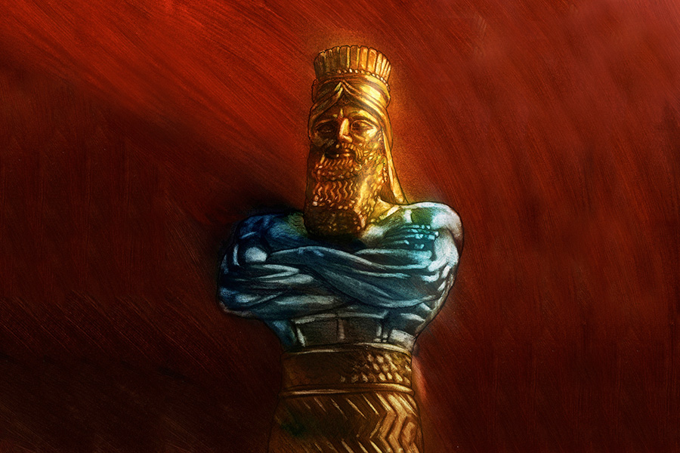
36 “This was the dream; now we will tell the king its interpretation. 37 Your Majesty, you are king of kings. The God of heaven has given you sovereignty, power, strength, and glory. 38 Wherever people live—or wild animals, or birds of the air—He has handed them over to you and made you ruler over them all. You are the head of gold.

Slide 9
39 “After you, there will arise another kingdom, inferior to yours, and then another, a third kingdom, of bronze, which will rule the whole earth. 40 A fourth kingdom will be as strong as iron; for iron crushes and shatters everything, and like iron that smashes, it will crush and smash all the others. 41 You saw the feet and toes, partly of a potter’s fired clay and partly of iron—it will be a divided kingdom,

Slide 10
though some of the strength of iron will be in it. You saw the iron mixed with clay, 42 and that the toes of the feet were partly iron and partly fired clay—part of the kingdom will be strong, and part will be brittle. 43 You saw the iron mixed with clay—the peoples will mix with one another but will not hold together, just as iron does not mix with fired clay.

Slide 11
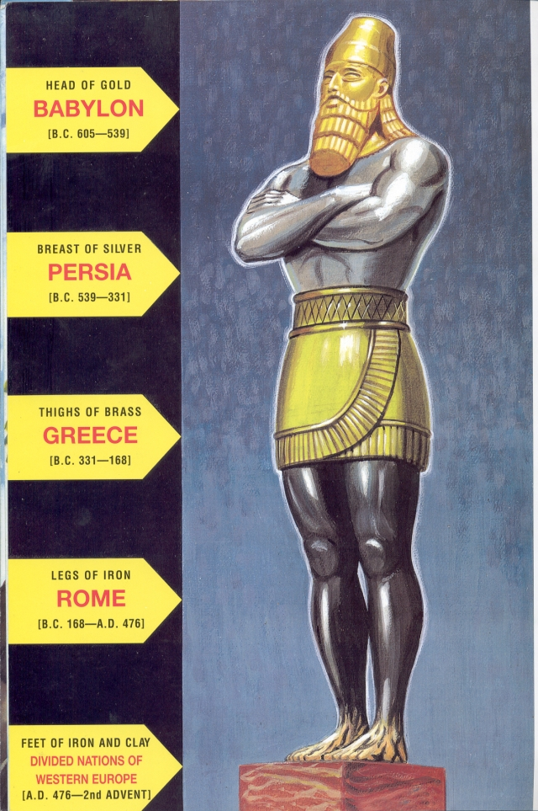
Declining Glory of Earthly Kingdoms

Slide 12
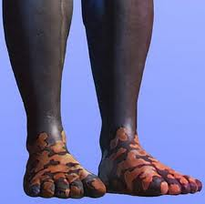
Feet and Toes of Iron and Clay Views: 1. Divided Roman Empire 2. Proceeding Kingdoms 3. Islam 4. America 5. Restored Roman Empire. Dan 7:24; Rev 17:12. 6. ?????

Slide 13
Feet and Toes of Iron and Clay What we know: 1. A Divided Kingdom v41 2. Strong, but brittle 3. Related to Rome/Iron 4. Mixed Ethnic v43 the peoples will mix with one another but will not hold together, 5. Controls Israel

Slide 14
44 “In the days of those kings, the God of heaven will set up a kingdom that will never be destroyed, and this kingdom will not be left to another people. It will crush all these kingdoms and bring them to an end, but will itself endure forever. 45 You saw a stone break off from the mountain without a hand, and it crushed the iron, bronze, fired clay, silver, and gold. The great God has told the king what will happen in the future. The dream is true, and its interpretation certain.”

Slide 15
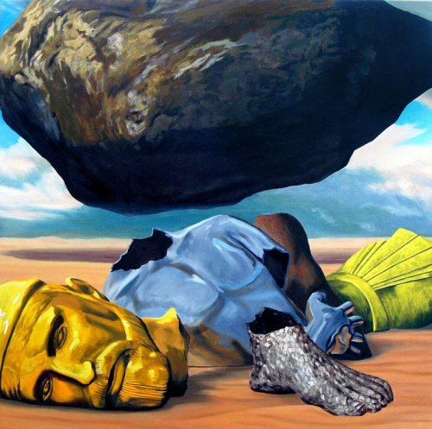
Stone – The Greatest and Eternal Kingdom

Slide 16
Stone – The Greatest and Eternal Kingdom - Created by God v44 - Never to be Destroyed v44 - It will destroy all other Kingdoms v44 - A great Kingdom, which will fill the whole earth. v35b But the stone that struck the statue became a great mountain and filled the whole earth.

Slide 17
Stone – The Greatest and Eternal Kingdom Jesus is this Stone Psalm 118:22 The stone that the builders rejected has become the cornerstone.

Slide 18
46 Then King Nebuchadnezzar fell down, paid homage to Daniel, and gave orders to present an offering and incense to him. 47 The king said to Daniel, “Your God is indeed God of gods, Lord of kings, and a revealer of mysteries, since you were able to reveal this mystery.” 48 Then the king promoted Daniel and gave him many generous gifts. He made him ruler over the entire province of Babylon and chief

Slide 19
governor over all the wise men of Babylon. 49 At Daniel’s request, the king appointed Shadrach, Meshach, and Abednego to manage the province of Babylon. But Daniel remained at the king’s court.

Slide 20
God is revealing himself to people. We have been given the privilege to share Him with them. But it’s a process.

Slide 21
God knows everything! Do you believe it and if you do what are doing about it?

