Slide 1
Loving God and Our Community

Slide 2
Thriving in Babylon

Slide 3
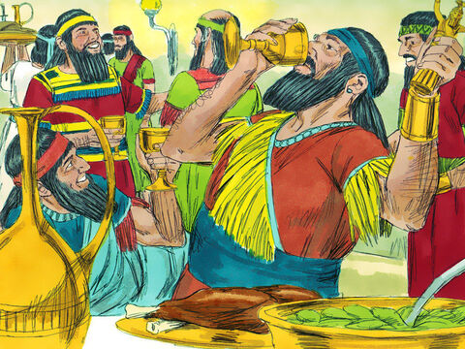
Dan 5:1 King Belshazzar held a great feast for 1,000 of his nobles and drank wine in their presence. 2 Under the influence of the wine, Belshazzar gave orders to bring in the gold and silver vessels that his predecessor Nebuchadnezzar had taken from the temple in Jerusalem, so that

Slide 4
the king and his nobles, wives, and concubines could drink from them. 3 So they brought in the gold vessels that had been taken from the temple, the house of God in Jerusalem, and the king and his nobles, wives, and concubines drank from them.

Slide 5
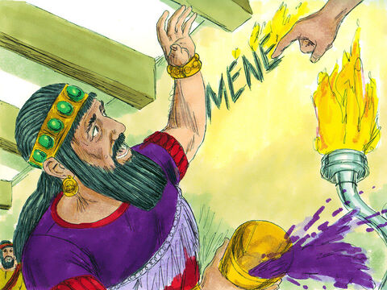
4 They drank the wine and praised their gods made of gold and silver, bronze, iron, wood, and stone. 5 At that moment the fingers of a man’s hand appeared and began writing on the plaster of the king’s palace wall next to the lampstand. The king watched the hand

Slide 6
as it wrote. 6 His face turned pale and he was so frightened that his legs became weak and his knees were knocking. 7 The king called out to bring in the mediums, Chaldeans, and astrologers. He said to these wise men of

Slide 7
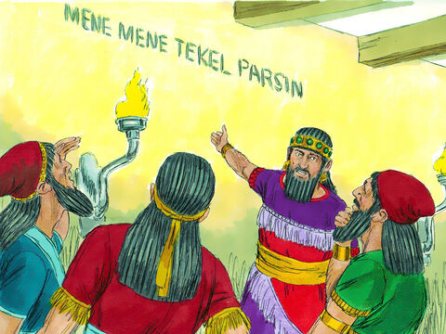
Babylon, “Whoever reads this inscription and gives me its interpretation will be clothed in purple, have a gold chain around his neck, and have the third highest position in the kingdom.” 8 So all the king’s wise men came in, but none could read the inscription or make its

Slide 8
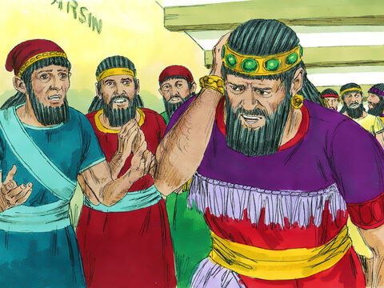
interpretation known to him. 9 Then King Belshazzar became even more terrified, his face turned pale, and his nobles were bewildered.

Slide 9
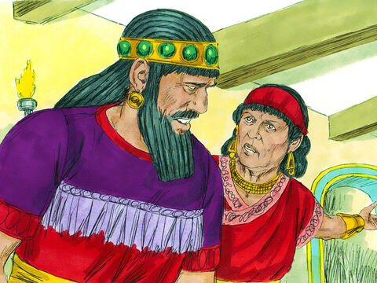
10 The queen, hearing the voices of the king and his nobles, came into the banquet hall. “May the king live forever!” she said. “Don’t be alarmed! Don’t look so pale! 11 There is a man in your kingdom who has the spirit of the holy gods in him. In the time of your father he was found to

Slide 10
have insight and intelligence and wisdom like that of the gods. Your father, King Nebuchadnezzar, appointed him chief of the magicians, enchanters, astrologers and diviners. 12 He did this because Daniel, whom the king called Belteshazzar, was found to have a keen mind and

Slide 11
knowledge and understanding, and also the ability to interpret dreams, explain riddles and solve difficult problems. Call for Daniel, and he will tell you what the writing means.”

Slide 12
13 So Daniel was brought before the king, and the king said to him, “Are you Daniel, one of the exiles my father the king brought from Judah? 14 I have heard that the spirit of the gods is in you and that you have insight, intelligence and outstanding wisdom. 15 The wise men and enchanters were brought before me to read this writing and tell me what it means, but they could

Slide 13
not explain it. 16 Now I have heard that you are able to give interpretations and to solve difficult problems. If you can read this writing and tell me what it means, you will be clothed in purple and have a gold chain placed around your neck, and you will be made the third highest ruler in the kingdom.”

Slide 14
17 Then Daniel answered the king, “You may keep your gifts for yourself and give your rewards to someone else. Nevertheless, I will read the writing for the king and tell him what it means. 18 “Your Majesty, the Most High God gave your father Nebuchadnezzar sovereignty and greatness and glory and splendor.

Slide 15
19 Because of the high position he gave him, all the nations and peoples of every language dreaded and feared him. Those the king wanted to put to death, he put to death; those he wanted to spare, he spared; those he wanted to promote, he promoted; and those he wanted to humble, he humbled. 20 But when his heart became arrogant and hardened with pride, he was

Slide 16
deposed from his royal throne and stripped of his glory. 21 He was driven away from people and given the mind of an animal; he lived with the wild donkeys and ate grass like the ox; and his body was drenched with the dew of heaven, until he acknowledged that the Most High God is sovereign over all kingdoms on earth and sets over them anyone he wishes.

Slide 17
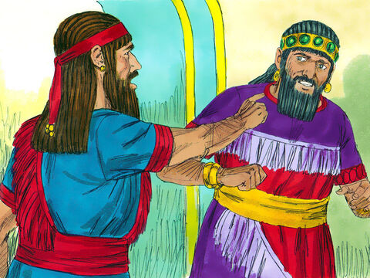
22 “But you, Belshazzar, his son, have not humbled yourself, though you knew all this. 23 Instead, you have set yourself up against the Lord of heaven. You had the goblets from his temple brought to you, and you and your nobles, your wives and your concubines drank wine from them.

Slide 18
You praised the gods of silver and gold, of bronze, iron, wood and stone, which cannot see or hear or understand. But you did not honor the God who holds in his hand your life and all your ways.

Slide 19
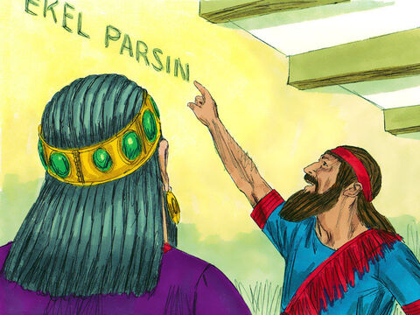
24 Therefore, He sent the hand, and this writing was inscribed. 25 “This is the writing that was inscribed: MENE, MENE, TEKEL, PARSIN. 26 This is the interpretation of the message:

Slide 20
MENE means that God has numbered the days of your kingdom and brought it to an end. 27 TEKEL means that you have been weighed in the balance and found wanting. 28 PERES means that your kingdom has been divided and given to the Medes and Persians.”

Slide 21
29 Then Belshazzar gave an order, and they clothed Daniel in purple, placed a gold chain around his neck, and issued a proclamation concerning him that he should be the third ruler in the kingdom. 30 That very night Belshazzar the king of the Chaldeans was killed, 31 and Darius the Mede received the kingdom at the age of 62.

Slide 22
He Trusted in the Things of this World King Belshazzar was feeling safe and comfortable, partying while enemy had his city surrounded. 1 King Belshazzar held a great feast for 1,000 of his nobles and drank wine in their presence.

Slide 23
He Trusted in the Things of this World The walls were said to have not been breached in 100 years. - the outer walls were 27km long. - the walls were 7m thick & 28m high. - the outer walls had guard towers another 30m high. - the gates were made of bronze. - it had a system of inner and outer walls and moats that made the city very secure.

Slide 24
He Trusted in his gods. King Belshazzar drank out of the cups of a defeated God. 4 They drank the wine and praised their gods made of gold and silver, bronze, iron, wood, and stone. An act of misplaced faith and arrogance.

Slide 25
He had forgotten about what his grandfather had learned!

Slide 26
God is Sovereign over Nations 18 Your Majesty, the Most High God gave sovereignty, greatness, glory, and majesty to your predecessor Nebuchadnezzar. v19 And because of the greatness that he gave him, all peoples, nations, and languages trembled and feared before him. 20b he was brought down from his kingly throne, and his glory was taken from him.

Slide 27
God is Sovereign over Nations Job 12:23 He makes nations great, and destroys them; he enlarges nations, and disperses them.

Slide 28
God Humbles the Proud 20 But when his heart was exalted and his spirit became arrogant, he was deposed from his royal throne and his glory was taken from him. 22 “But you, Belshazzar, his son, have not humbled yourself, though you knew all this. 23 Instead, you have set yourself up against the Lord of heaven.

Slide 29
God Humbles the Proud James 4:6 God Opposes the proud

Slide 30
God Exalts the Humble 21b until he acknowledged that the Most High God is ruler over the kingdom of men and sets anyone He wants over it. James 4:6 but gives grace to the humble Beltshazzar refused to repent and humble himself before the Lord.

Slide 31
God Exalts the Humble 2 Chr 33:12 In his distress he sought the favor of the Lord his God and humbled himself greatly before the God of his ancestors. 13 And when he prayed to him, the Lord was moved by his entreaty and listened to his plea; so he brought him back to Jerusalem and to his kingdom. Then Manasseh knew that the Lord is God.

Slide 32
God Is the Give and Taker of Life 23c But you have not glorified the God who holds your life-breath in His hand and who controls the whole course of your life. Contrasted to his gods 23b you praised the gods made of silver and gold, bronze, iron, wood, and stone, which do not see or hear or understand.

Slide 33
God Judges Humanity 22 “But you his successor, Belshazzar, have not humbled your heart, even though you knew all this. 23 Instead, you have exalted yourself against the Lord of heaven. God knows the hearts of man and judges righteously.

Slide 34
God Judges Humanity v26 MENE God has numbered the days of your kingdom and brought it to an end. 27 TEKEL means that you have been weighed in the balance and found deficient. Ps 82:8 Arise, O God, judge the earth

Slide 35
God Judges Humanity 2 Cor 5:10 For we must all appear before the judgment seat of Christ, so that each of us may receive what is due us for the things done while in the body, whether good or bad. Acts 17:31 because he has fixed a day on which he will judge the world in righteousness by a man whom he has appointed;

Slide 36
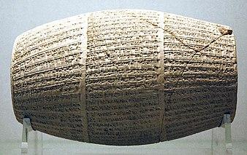
His Word Is Trustworthy King Belshazzar was considered evidence of the Bible’s historical inaccuracy. Until the discovery of the Cylinders of Nabonidus in 1854, which proved that he was co-regent with his father for 6 years. 7b and have the third highest position in the kingdom.

